Slide 1
Location Searching based on weather conditions
Coursera Capstone Project

Slide 2
Have you ever been looking for a place to have coffee in the sun but it is cloudy at your place?

Slide 3
Use Public available weather data to make this possible!
Weather data from DWD (German Weather Service)
Location Data from Foursquare

Slide 4
From the weather data use certain variables at every coordinate
Accumulated time of sunshine
Amount of rain
Temperature

Slide 5
Preprocessing
Transform each Variable into a categorical one:
Rain = [No Rain, little Rain, heavy rain]
Temperature = [Low, medium, high]
Sunshine Duration = [Low amount, medium amount, high amount ]

Slide 6
Cluster the data
Use K-means clustering:
K = 3
Each location gets it‘s own label (0, 1 or 2)
The clusters mean the following:
0 = rain is involved (bad weather)
1 = medium conditions (maybe not raining but at least cloudy)
2 = Perfect conditions to have your coffee at

Slide 7

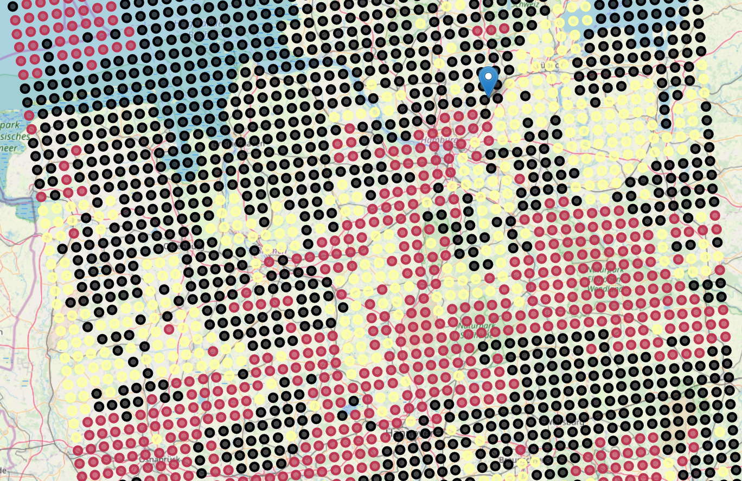
Clustered Data on a map
Shown is the area around Hamburg, Germany
The Location marker shows current location
The colors mean:
Black = Bad weather
Yellow = Medium good weather
Red = Perfect weather

Slide 8
Search for coffee near the next point with perfect weather
Place a Foursquare search request
Take the first result, because it will be closest to the target location

Slide 9
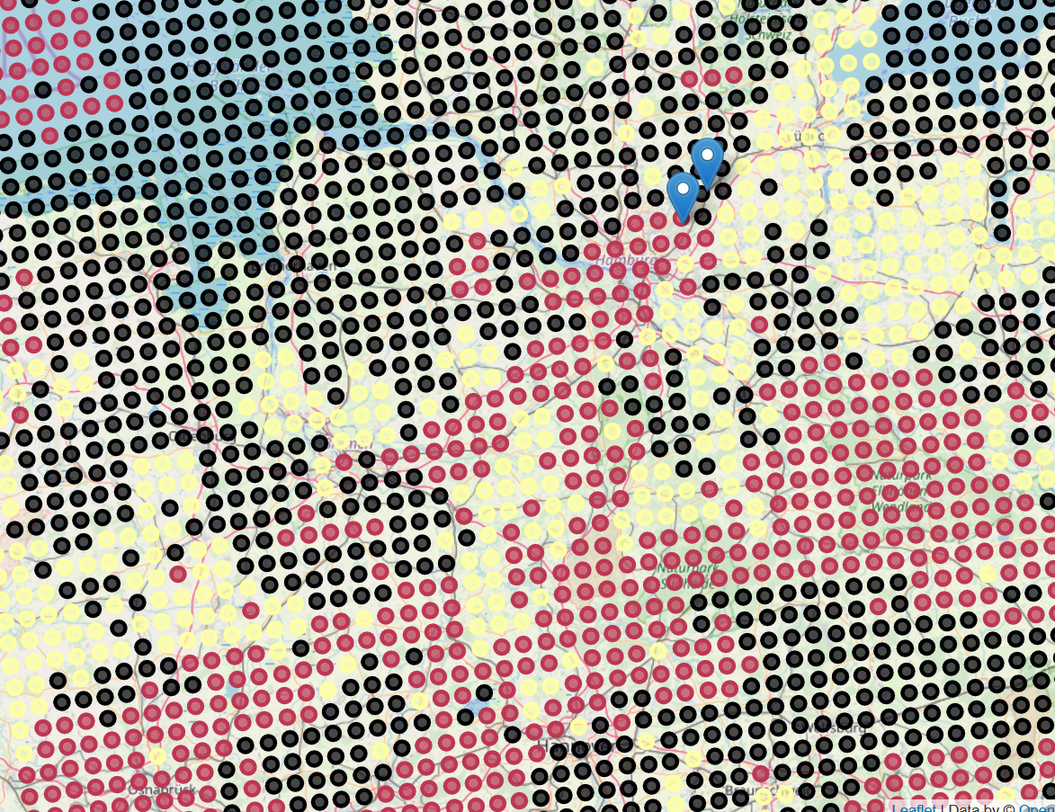
Found perfect location
One of the markers show your location (in the black, bad weather area)
Other marker shows target coffee shop in perfect weather conditions

Slide 10
Would you still drink your coffee in the rain or rather drive 5 minuts by car to enjoy your Coffee outside?

